Slide 1
EHRFlow: A Large Language Model-Driven Iterative Multi-Agent
Electronic Health Record Data Analysis Workflow
Yinghao Zhu¹, Junyi Gao^{2,3}, Liantao Ma¹, et al.
Presenter: Junyi Gao
1 Peking University
2 University of Edinburgh
3 Health Data Research UK
Notes:
Good afternoon, everyone. Today, I’m glad to present our work on 'EHRFlow: A Large Language Model-Driven Iterative Multi-Agent Electronic Health Record Data Analysis Workflow.' This work is a collaborative effort led by Yinghao Zhu, myself—Junyi Gao—and Liantao Ma, among others. We are proud to represent the peking university, University of Edinburgh and health data research uk, working together with other institutions. Let's dive into how this approach is designed to enhance the analysis of Electronic Health Record data.

Slide 2
Table of Contents
Background
Motivation
Related Work
Methodology
Platform Demo
Future Work

Slide 3
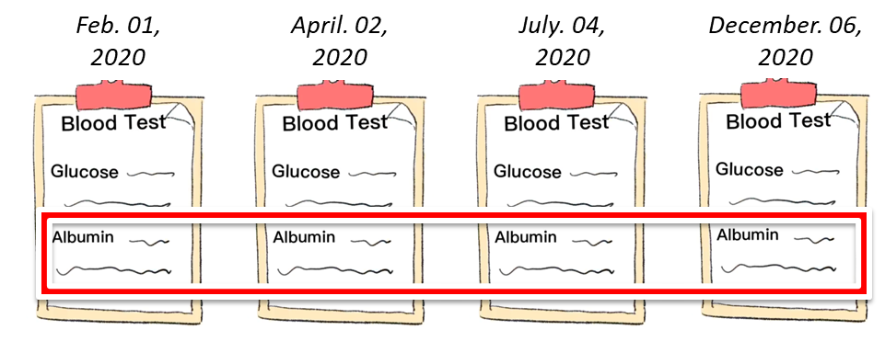
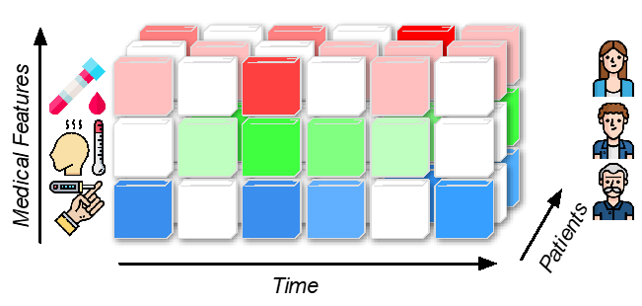
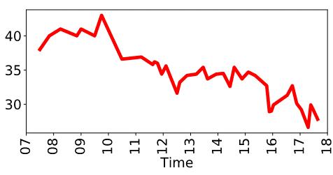
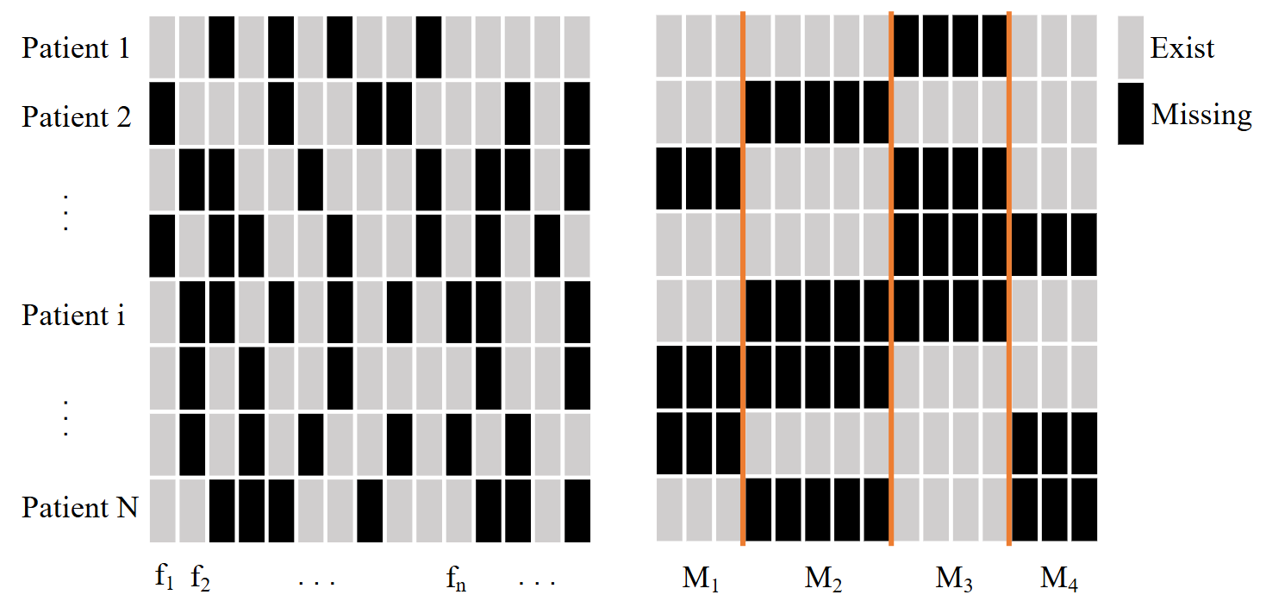
Background: Electronic Health Record (EHR)
EHR data
Multimodal, irregular, longitudinal, sparse, high-dimensional
High-dimensional
Irregular
Longitudinal
Sparse
Notes:
First, let's delve into the background of Electronic Health Records, or EHRs. What makes EHR data particularly challenging is its nature—it's often irregular, longitudinal, sparse, and highly dimensional.
For example, the data can be irregular, as seen in the varying intervals between blood tests over time. It's also longitudinal, tracking patient information across different time points. Additionally, EHR data is high-dimensional, involving numerous features across many patients, and it's sparse, with many missing or unavailable data points.

Slide 4
Motivation
EHR data is complicated but commonly used in physicians' daily decision-making.
→ Skill barrier and repetitive works in EHR analysis
LLMs provide new opportunity to boost the traditional EHR analysis pipeline.
Can we directly ask LLMs to diagnose?
→ Data privacy issues
→ Hallucinations
→ GPT-based model structural limitations
Notes:
So all these complexity of EHR data build our motivation. EHR data is frequently used in physicians' daily decision-making processes. This complexity often creates a skill barrier and leads to repetitive tasks in EHR analysis, for example data observation, imputation and normalization. All these tasks need to be done again and again when processing different data, and often requires the clinicians to have high coding abilities, especially for applying deep learning models. All these difficulties make it difficult for clinicians and junior medical informatics researchers to utilize or even try the ML or DL algorithms.
Large Language Models (LLMs) present a new opportunity to enhance the traditional EHR analysis pipeline. Many people belives that LLMs can reduce the workload of research workflows.
However, can we directly ask LLMs to diagnose?
Apparently it’s unpractical in clinical practice. There are significant challenges that come with this, including data privacy concerns, the potential for generating hallucinations, and structural limitations inherent to GPT-based models. The decoder structure make it difficult to understand structural longitudinal EHR data. These issues are especially significant in healthcare settings, where mistakes can cause high costs.

Slide 5
Motivation
How to build accessible LLM-driven EHR analysis pipeline, while ensuring it’s trustworthy?
[Our solution] Make LLMs utilize existing tools and expert predictive models, instead of directly giving an unverified answers.
Notes:
……Where these models can be validated and selected by clinicians.

Slide 6
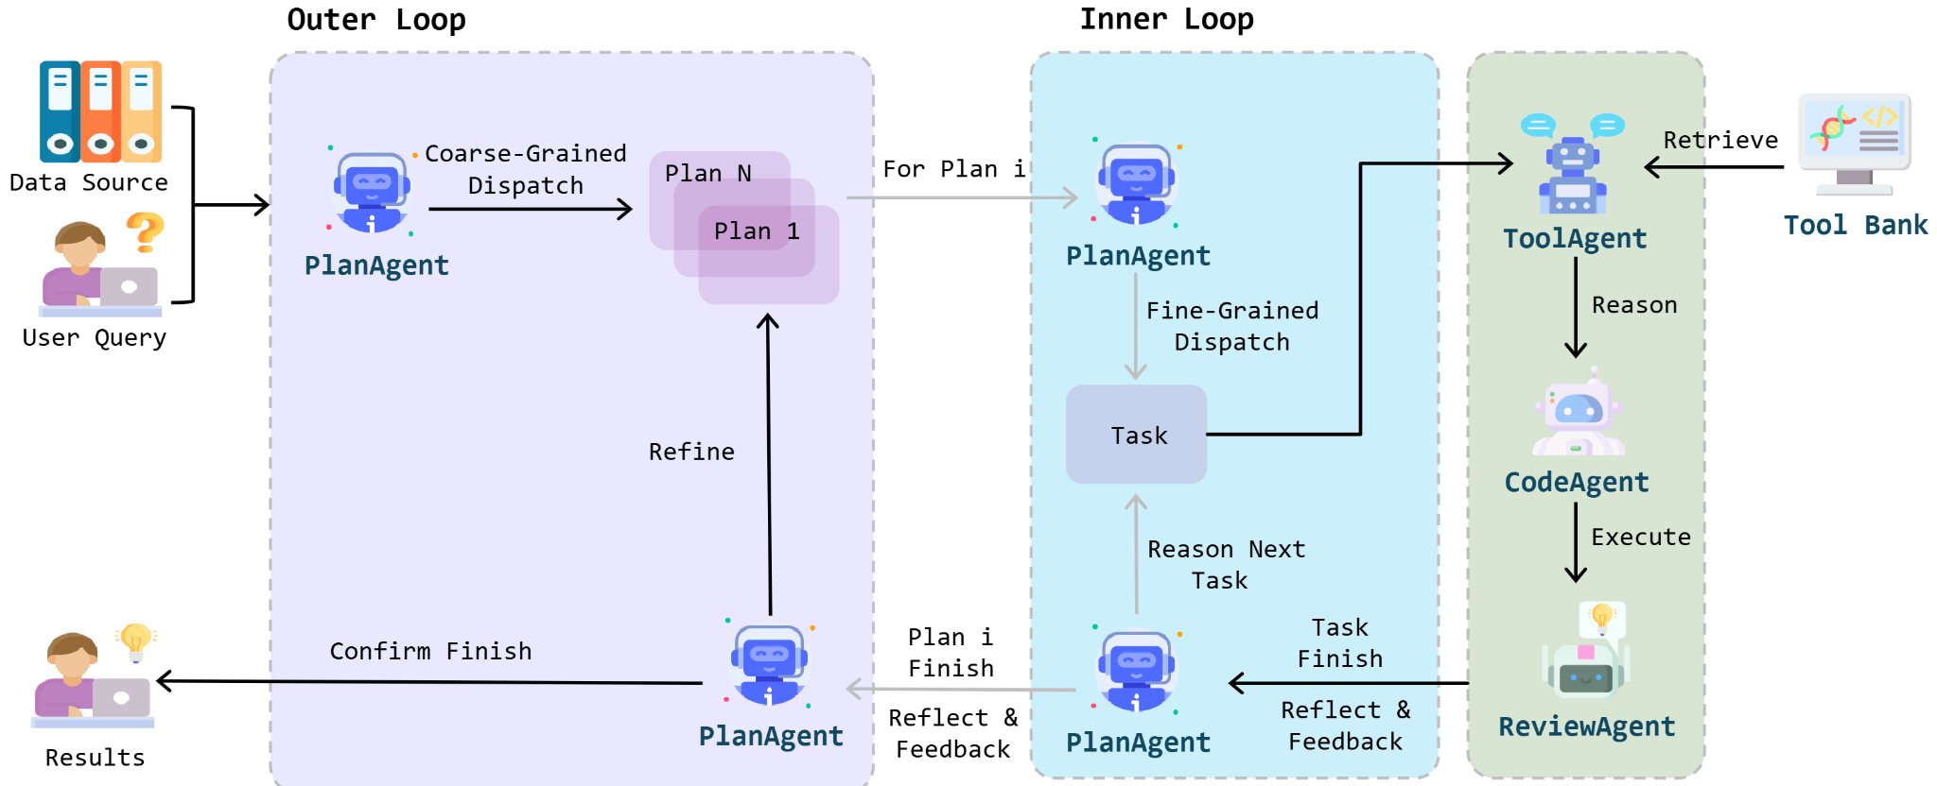
Methodology
EHRFlow: Given the target and data, complete the analysis without human intervention.
Divide a complex target into several plans
Generate the code and execute
Review the execution results and make feedbacks
[Overview of EHRFlow]
(pre-defined tools. i.e. APIs, function calls)
EHRFlow accepts user’s natural language queries, and consists of the hierarchical dual-loop processes
Notes:
Let's now dive into the methodology behind EHRFlow, our iterative multi-agent system driven by Large Language Models (LLMs). The main target of HER flow is Given the target and data, complete the analysis without human intervention.
Generally, it consists of three steps.

Slide 7
Methodology
Four main agents: PlanAgent, ToolAgent, CodeAgent, and ReviewAgent
Dual-loop mechanism:
Outer loop: Task decomposition into course-grained plans
Inner loop: For each plan, fine-grained tasks dispatch, execution, and reflection
Privacy protection: Only data schema provided, sensitive operations executed locally
[Overview of EHRFlow]
(pre-defined tools. i.e. APIs, function calls)
EHRFlow accepts user’s natural language queries, and consists of the hierarchical dual-loop processes
Notes:
EHRFlow operates using four main agents: PlanAgent, ToolAgent, CodeAgent, and ReviewAgent, each contributing to different stages of the data analysis process.
The system follows a dual-loop mechanism:
The Outer Loop is responsible for decomposing user queries into coarse-grained plans, managed by the PlanAgent.
The Inner Loop involves fine-grained task dispatch, execution, and reflection for each plan, where the PlanAgent further refines tasks and collaborates with the ToolAgent, CodeAgent, and ReviewAgent.
Privacy protection is a core aspect of EHRFlow. The system only handles data schemas, ensuring that sensitive operations are executed locally and securely, thereby safeguarding patient data.

Slide 8
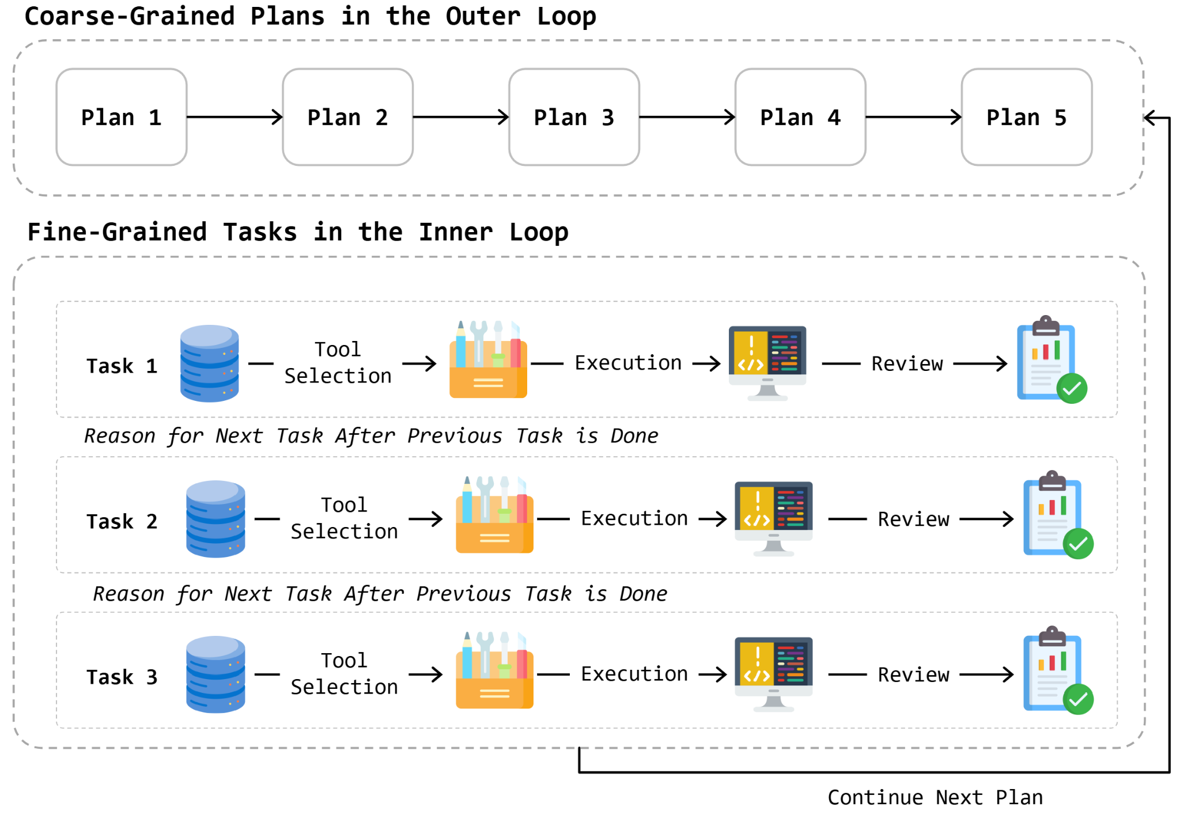
Methodology
EHRFlow: Iterative multi-agent system driven by LLMs
Four main agents: PlanAgent, ToolAgent, CodeAgent, and ReviewAgent
Dual-loop mechanism:
Outer loop: Task decomposition into course-grained plans
Inner loop: For each plan, fine-grained tasks dispatch, execution, and reflection
Privacy protection: Only data schema provided, sensitive operations executed locally
[Overview of EHRFlow]
Illustration of plan and task decomposition and execution pipeline in the loop
Notes:
Let’s now take a look at the example execution of the framework.
In the Outer Loop, the system begins by generating coarse-grained plans, which are sequentially executed from Plan 1 to Plan 5. Each plan represents a higher-level task that needs to be broken down further for detailed execution.
The Inner Loop handles the fine-grained tasks within each plan. Each task goes through a systematic process: first, the relevant tools are selected, then the task is executed, and finally, the results are reviewed. This review includes reasoning about the next task based on the previous task’s outcome. Once all tasks within a plan are completed, the system moves on to the next plan in the Outer Loop.
We provide a rich function tools including imputation, normalization, training and evaluation and different prediction models. We also provide comprehensive descritptions and documentations to help llms understand the usage of tools.
This dual-loop approach ensures that complex queries are systematically broken down, addressed with appropriate tools, and thoroughly reviewed to ensure accuracy and relevance.

Slide 9
Requirement: Please create a histogram of patient Feature Importance for predicting 1-year patient mortality
A complex target that requires multi-step plans:
Read data
Preprocess data
normalize
imputation
split dataset
…
Train an interpretable model
Inference
Extract model’s feature importance outputs
Plot the figure

Slide 13
Future Work
Continue refining the EHRFlow platform, integrate more tools, support multimodalities
Offer more customizable options. Instead of an end-to-end execution, the LLM could engage in multi-round interactions, asking the user to confirm parameter options.
User validation, collect feedback for continuous improvements
With EHRFlow, we aim to expand the reach of AI services in healthcare:
AI has the potential to be applied in various hospitals and research departments.
This will enable AI services to reach and benefit a much broader patient and researcher population.

Slide 14
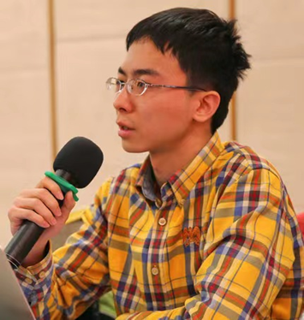
Leading Authors
Junyi Gao
University of Edinburgh
PhD Student
junyii.gao@gmail.com
Yinghao Zhu
University of Zurich
Incoming PhD Student
yhzhu99@gmail.com
Liantao Ma
Peking University
Research Assistant Professor
malt@pku.edu.cn
Research Interest
Individual healthcare predictive modelling
Spatio-temporal prediction
Clinical trial optimization
Research Interest
EHR data mining
Healthcare multimodal foundation models
Research Interest
AI for healthcare
Interpretable deep learning
Multivariate EHR analysis
Notes:
Before diving into the details of our work, I would like to introduce the leading authors of this project. First, there's myself, Junyi Gao, a PhD student at the University of Edinburgh. My research interests include individual healthcare predictive modeling, spatio-temporal prediction, and clinical trial optimization.
Next, we have Yinghao Zhu, an incoming PhD student at the University of Zurich. Yinghao focuses on EHR data mining and healthcare multimodal foundation models.
Finally, Liantao Ma, a Research Assistant Professor at Peking University, who brings expertise in AI for healthcare, interpretable deep learning, and multivariate EHR analysis.
Together, we bring a diverse set of skills and perspectives to tackle the challenges in Electronic Health Record data analysis.

Slide 15
EHRFlow: A Large Language Model-Driven Iterative Multi-Agent
Electronic Health Record Data Analysis Workflow
Thanks!
Q&A
Yinghao Zhu, Junyi Gao, Liantao Ma, etc.

